Slide 1

Georgia College Green Initiative
A Major Campaign of the GC Sustainability Council
Tips for Students
Georgia College is one of the Greenest campuses in Georgia for utility usage!
Help make us the GREENEST!!

Slide 2
Green Initiative Mission
The Green Initiative is an effort to incorporate the principles of sustainability and environmental planning into the short-term and long-term activities of our university, and to share our knowledge with the surrounding community in an effort to make our world more ecologically responsible.

Slide 3
You can … Save Paper
Get a flash drive and use it to store your class-related materials
Encourage your faculty to post documents on a faculty web page. You can probably download them to a Blackberry or other portable electronic device.
Reflect when you print. If you must print, double side your copies, use narrow margins, single space, smaller or Sprang Ecofont.

Slide 4
You can … Save Energy!
Pay attention to your energy usage. Turn out lights when you leave a room.
Unplug appliances, don't just turn them off. If a little red light is on, they are using electricity. Plug all electronics into a power strip; turn it off when not in use.
Your dorm/apartment is not supposed to be the same temperature all year round. Wear warm clothes in the winter, cool clothes in the summer, and adjust the temperature accordingly.

Slide 5
You can … Save Water!
Pay attention to your water usage. Do you leave the water running while you brush your teeth or do the dishes?
Take shorter showers.
Report running faucets and toilets to physical plant (x4279).

Slide 6
You can … Save, Save, Save!!!
Use a refillable water bottle and coffee cup.
Walk more instead of taking the shuttle or your car. It saves gas and it makes you healthier.
Ride your bike! It’s fun.
Drive less – combine trips and do your shopping all at once. It saves time, gas, and money.
Get a cloth grocery bag or a mesh laundry bag and leave it in your car.

Slide 7
Recycling at Georgia College
Recycle: plastics (#1 & #2), metal cans (aluminum/tin/steel), newspaper, mixed paper, paperboard, and cardboard.
  Bins on main campus are for use on campus
  In Residence Halls, please take your materials to the convenience centers
https://gcgreen.wordpress.com/materials-recovery-and-recycling/

Slide 8
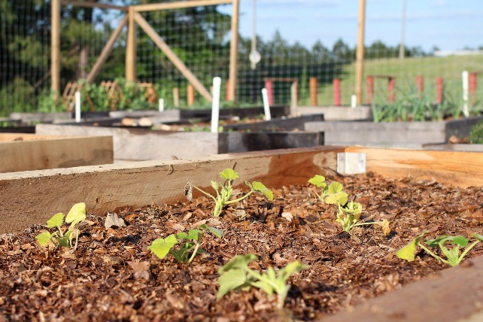
Together, we can…
Recycle when possible,
Reduce our use of valuable resources,
Reuse things before we create waste, and
Make Georgia College the Greenest Campus in GA!
http://gcsu.edu/green

