Slide 1

Georgia College Green Initiative
A Major Campaign of the GC Sustainability Council
Tips for Faculty
Georgia College is one of the Greenest campuses in Georgia for utility usage!
Help make us the GREENEST!!

Slide 2
Green Initiative Mission
The Green Initiative is an effort to incorporate the principles of sustainability and environmental planning into the short-term and long-term activities of our university, and to share our knowledge with the surrounding community in an effort to make our world more ecologically responsible.

Slide 3
Critical Areas of Activity
Building Design & Landscaping
Energy Conservation and Efficiency
Environmental Awareness & Education
Materials Management & Recycling
Transportation and Parking Options
Water Conservation & Wastewater Recovery

Slide 4
You can … Save Paper!
Use electronic resources, such as web pages, myCATS, DegreeWorks, and GeorgiaVIEW for teaching and advising whenever possible.
Reflect when you print copies. Will a soft copy be sufficient? If you must print, double side your copies, use narrow margins, single space, smaller or Sprang Ecofont.

Slide 5
You can … Save Energy!
Plug all electronics into a power strip; turn it off when not in use. Even standby mode wastes energy and money.
Turn out lights and projectors when you leave a room: the restroom, your office and the classroom.
Adjust your body temperature with your clothing choices instead of the thermostat.

Slide 6
You can … Save Energy and Water!
Adjust thermostats appropriately - 70° in winter and 75° in summer. Report temperature problems to physical plant
  workorders@gcsu.edu, x4279.
Keep windows closed; avoid space heaters as they affect all rooms in your building zone.
Report running faucets and toilets to physical plant. workorders@gcsu.edu, x4279

Slide 7
You can … Save, Save, Save!!!
Consider ride sharing/commuting – post at sale@list.gcsu.edu or Bobcat RideShare; check out the CarShare instead:
  Hertz On Demand
Use a refillable/reusable water bottle and coffee cup.
Recycle metal cans (aluminum/tin/steel), plastics (#1 & #2), mixed paper, newspaper, paperboard and cardboard.

Slide 8
You can … Teach Sustainability!
Incorporate sustainability into your course materials and lectures
Recommend courses to students/advisees
Relate our institution as a model of society; if we can teach sustainability here, students will take their knowledge, habits, and attitudes with them into the ‘real’ world

Slide 9
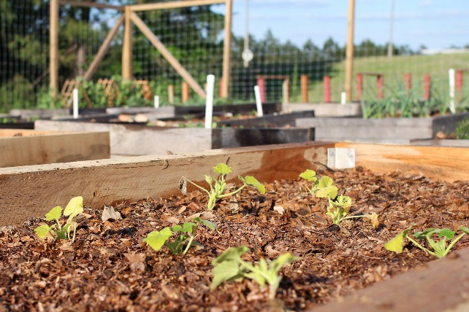
Together, we can…
Recycle when possible,
Reduce our use of valuable resources,
Reuse things before we create waste, and
Make Georgia College the Greenest Campus in GA!
http://gcsu.edu/green

