Slide 1
Georgia College
Sustainability Council
Green Bag Discussion Series
GC Recycling Plan
Dr. Doug R. Oetter
7 October 2014

Slide 2

Georgia College Sustainability Council
http://green.gcsu.edu/
Building Design and Landscaping Alternatives
Energy Conservation and Efficiency
Environmental Awareness and Education
Materials Management and Recycling
Transportation and Parking Options
Water Conservation and Wastewater Recovery
Sustainability: Living today in a way that allows future generations to live in their day

Slide 3
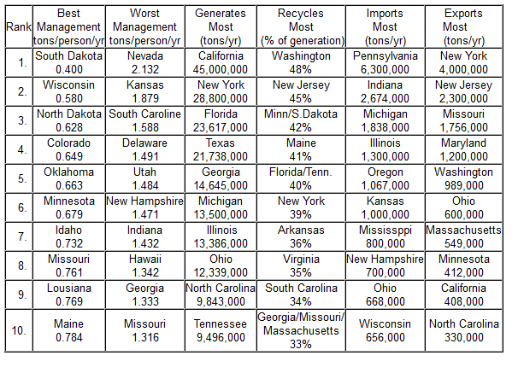
Where We Were
1998 Recycling Rates

Slide 4
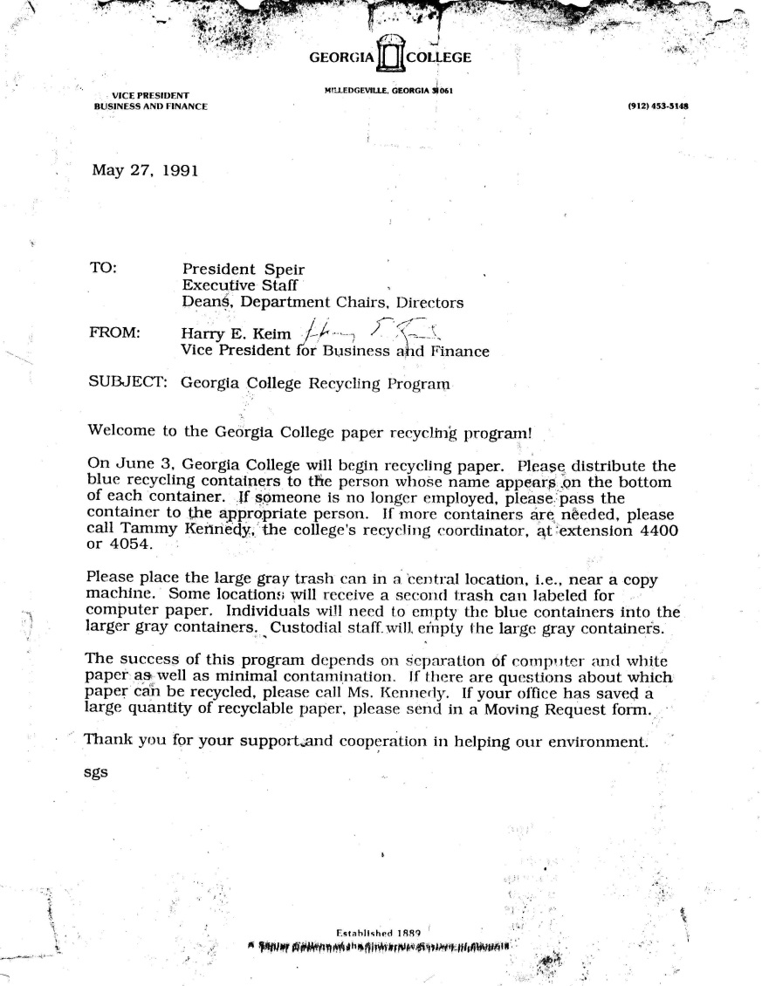
1991
1990 Recycling Project
  Paper recycling
  Bins issued to all faculty and staff
  Relied on custodians to process and secure
  Failed because of price drop and problems with management

Slide 5
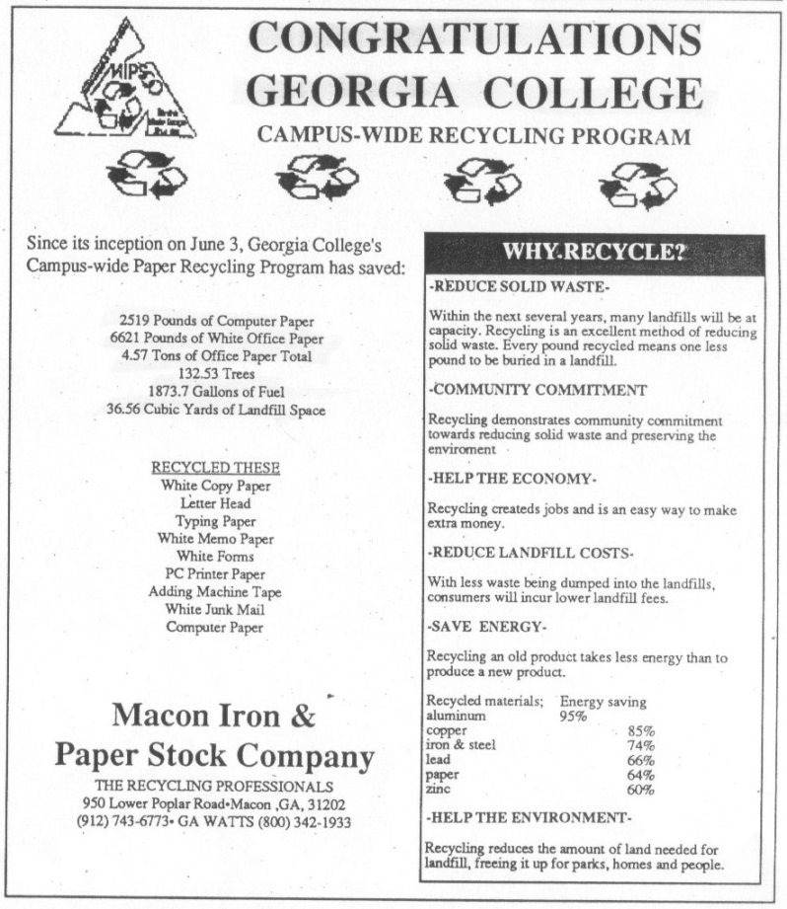
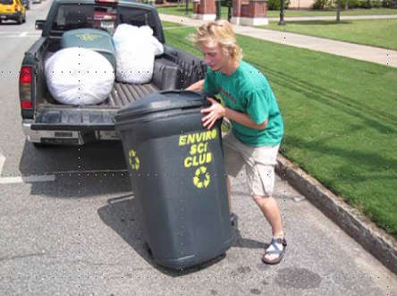
2004
Environmental Science Club
  White Paper Recycling Fundraiser
  Macon Iron & Paper Stock
    Now Schnitzer

Slide 6
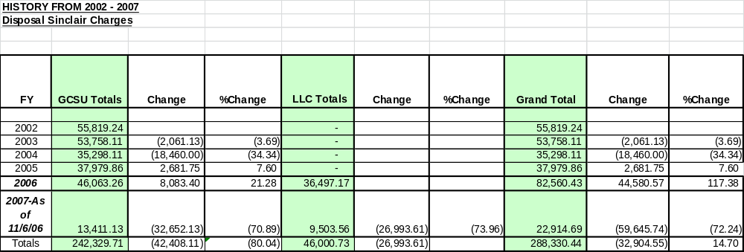
2006
Campus Growth
  New Buildings
  Increase in Students
  Mandatory First-Year Residence

Slide 7
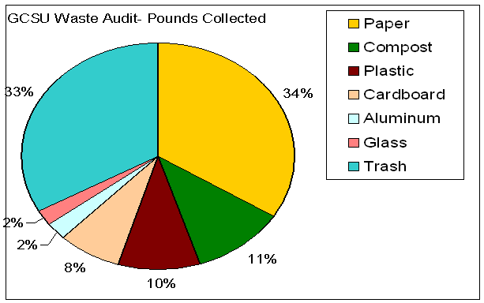
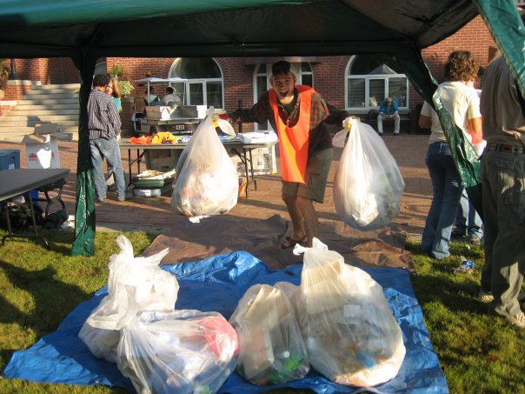
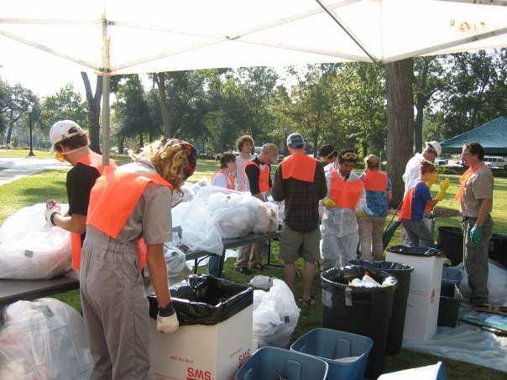
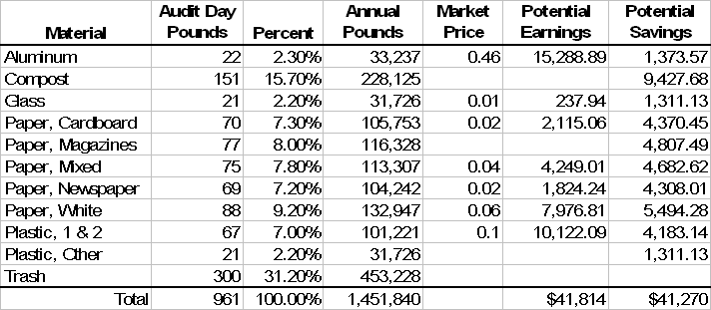
2006 Waste Audit

Slide 8
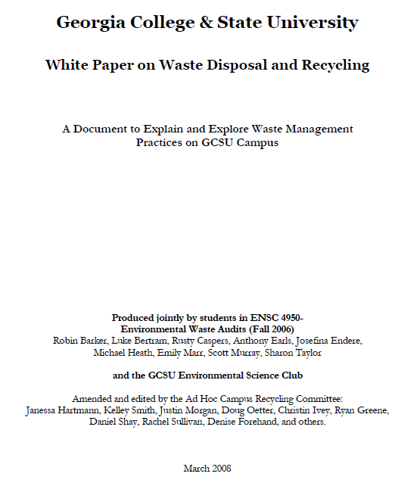
2008 “White” Paper

Slide 9
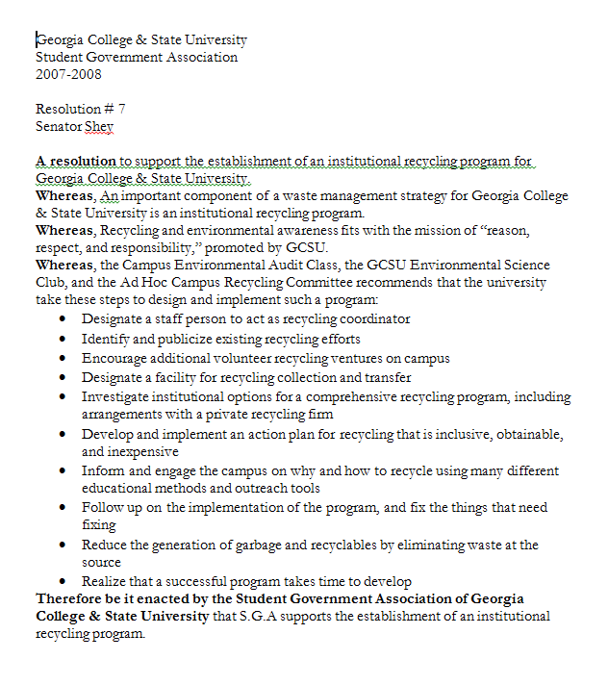
2008 University Senate & Student Government Association Recommendations

Slide 10
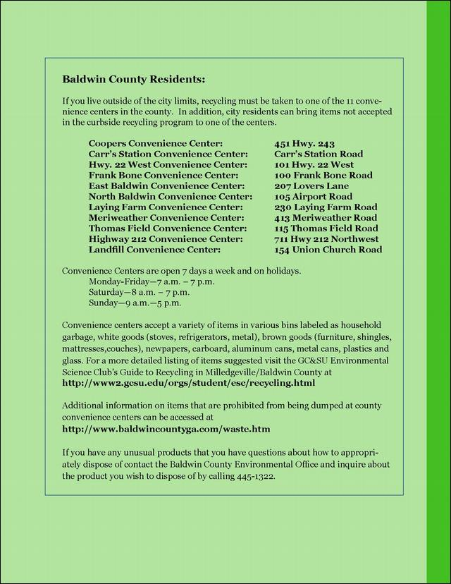
2009 City & County Recycling
Georgia Comprehensive Waste Management Act
County Drop-off Centers
  Disallowed City Residents
    Including Residence Halls and Apartment Complexes

Slide 11
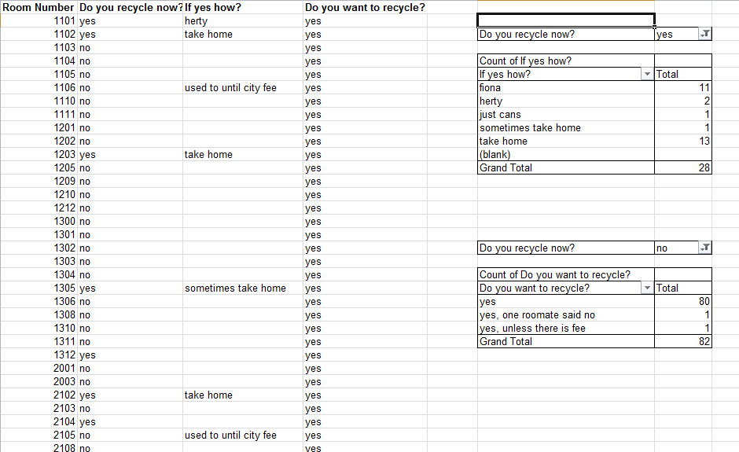
Student Responses
West Campus Bldg. 400
  Weekend Trips Home

Slide 12

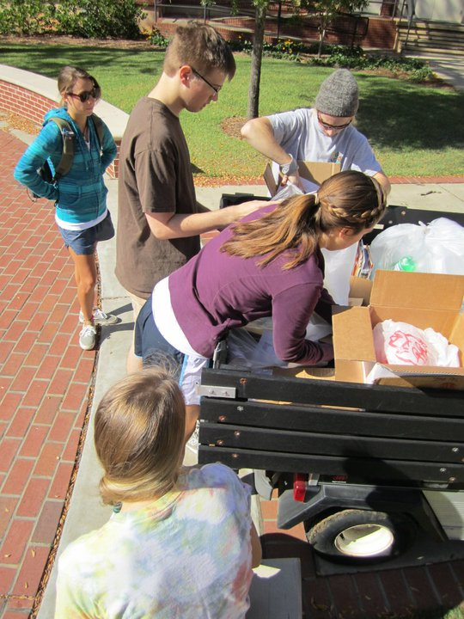
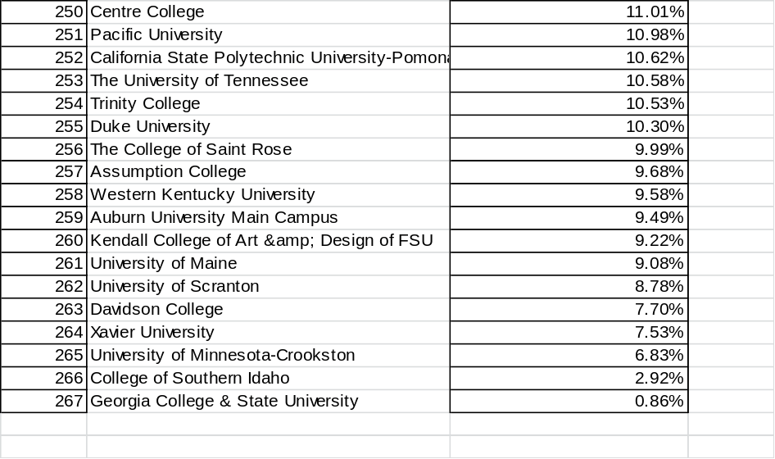
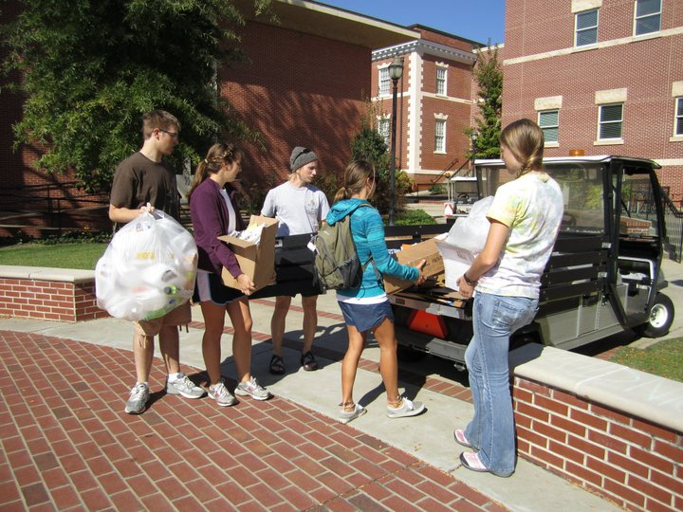
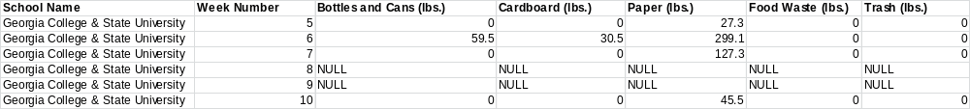
Recyclemania

Slide 13
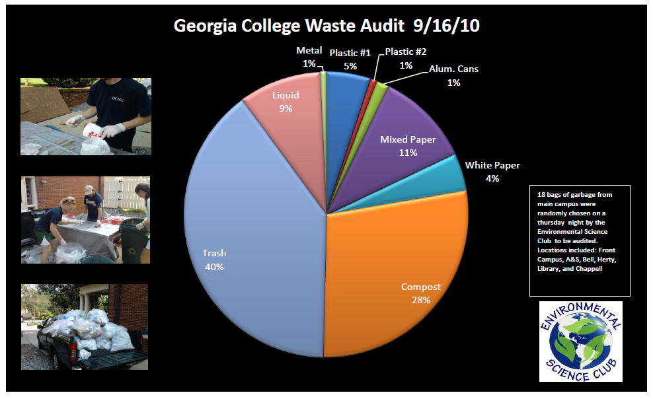
2010 Waste Audit

Slide 14

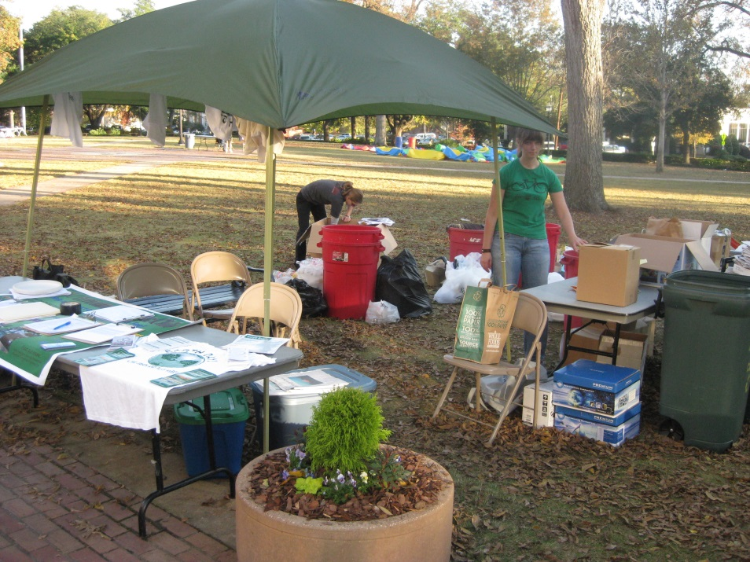
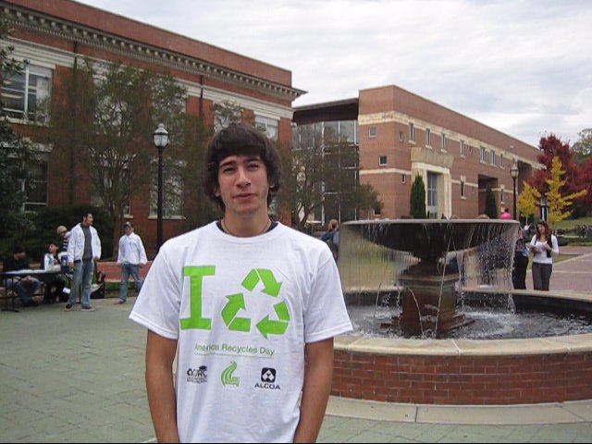
Recycling Volunteers
America Recycles Day (November 15th)

Slide 15
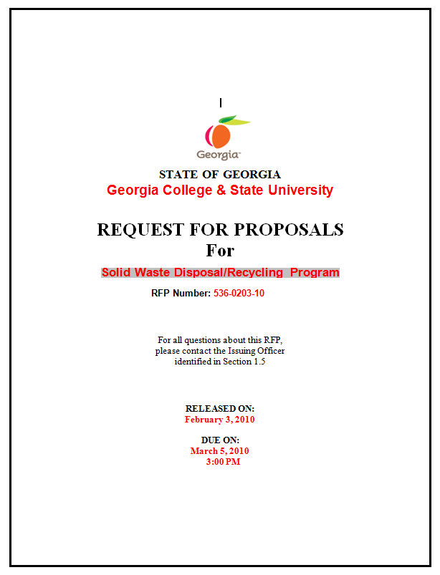


2010 Waste Management Contract

Slide 16
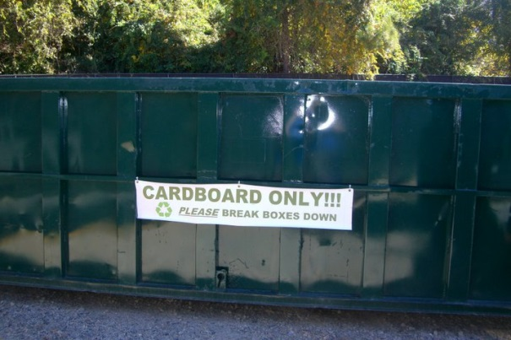
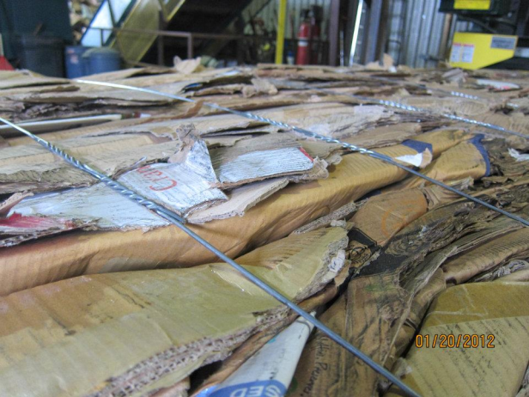
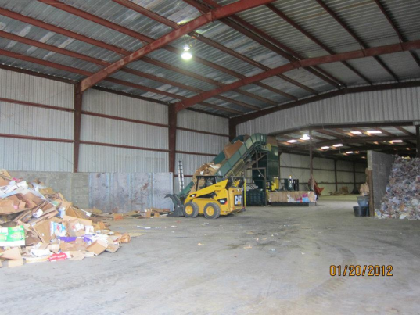
GC Recycling Program
Collection
Transportation
Recovery
Recapture

Slide 17
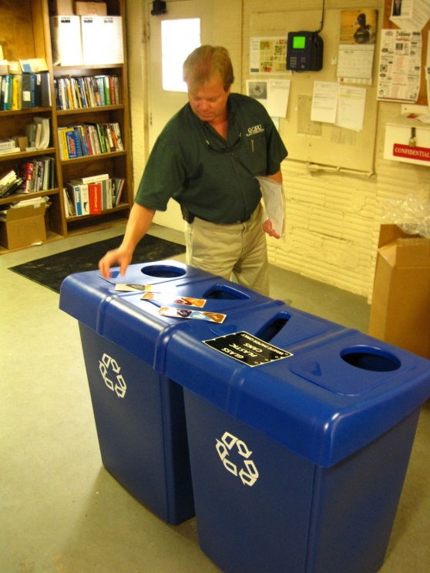
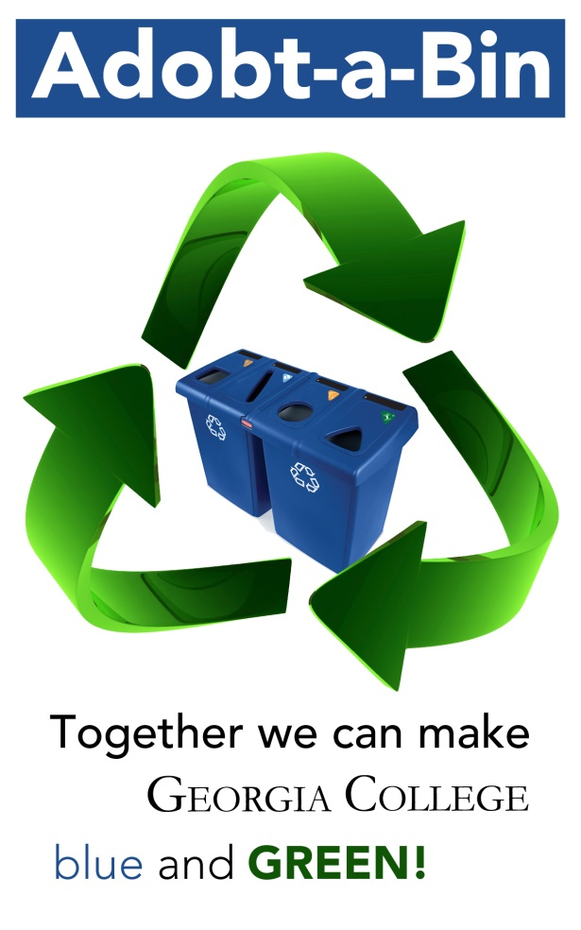
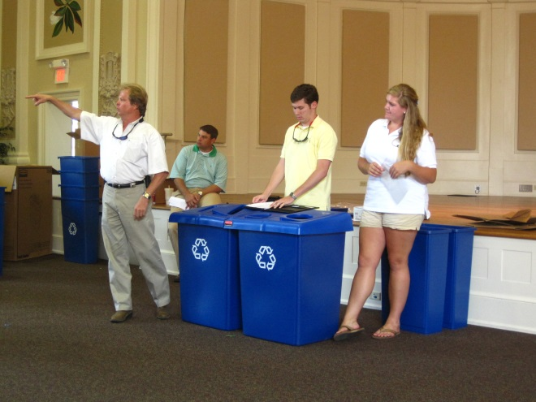
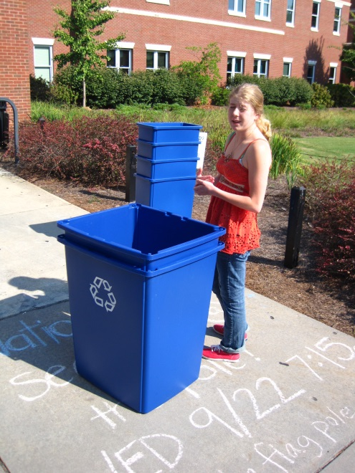
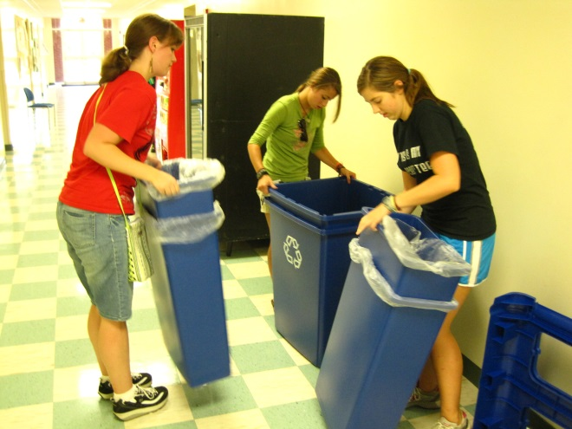
2010 Blue Bins

Slide 18
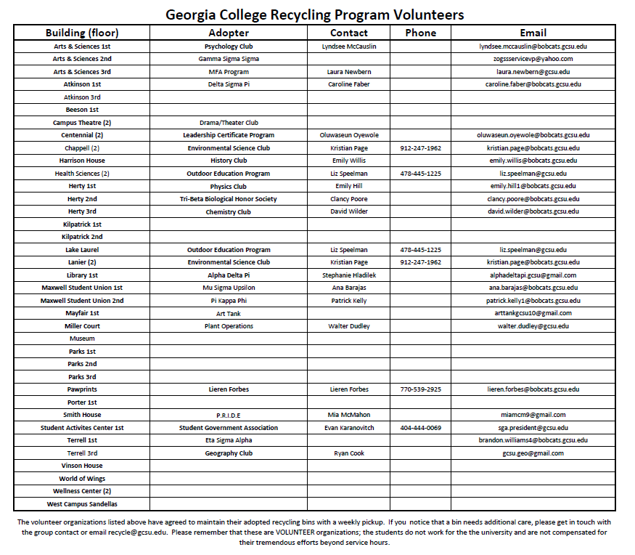

Slide 19
Problems with a Volunteer System
Attracting Volunteers
Maintaining Consistency
Reacting to Problems
Insufficient Coverage
Education
Participation
Rewards

Slide 20
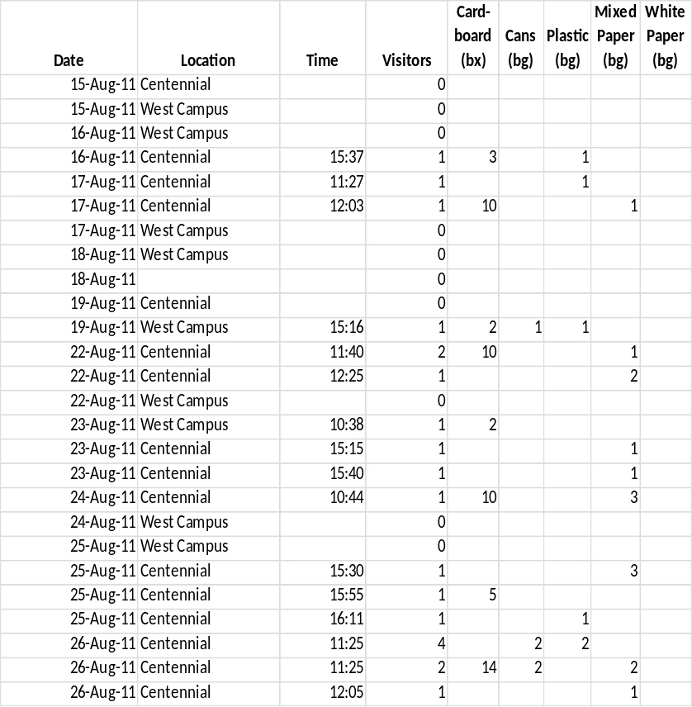
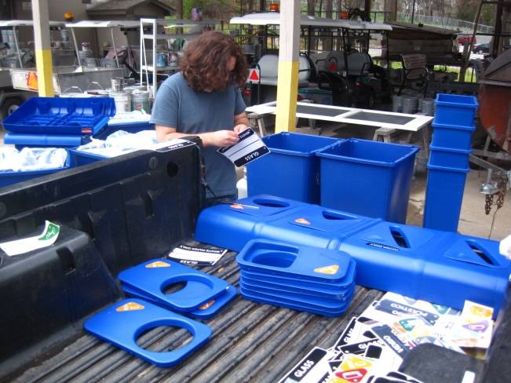
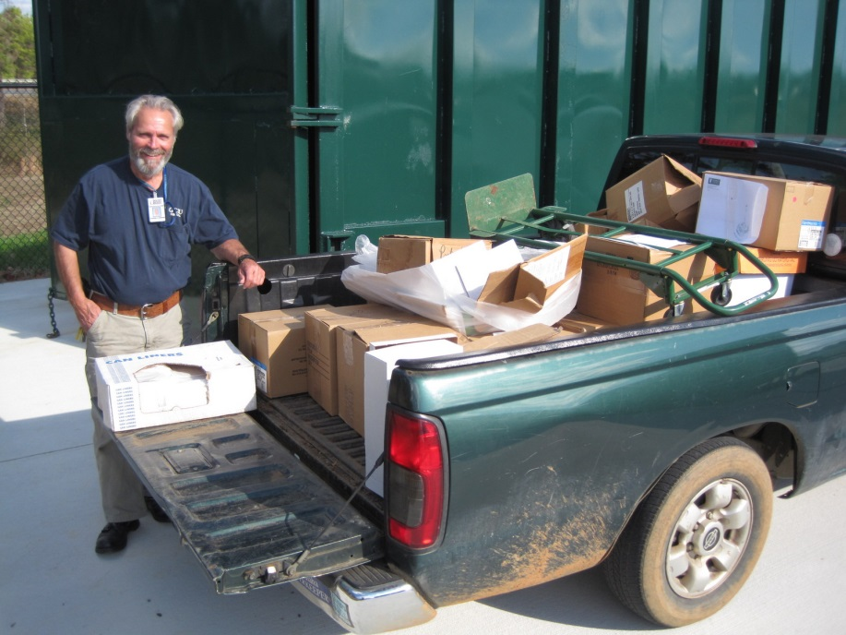
Staffed Campus Drop-Off Facilities
Charles & Earl
  Marcel & Lekitra

Slide 21
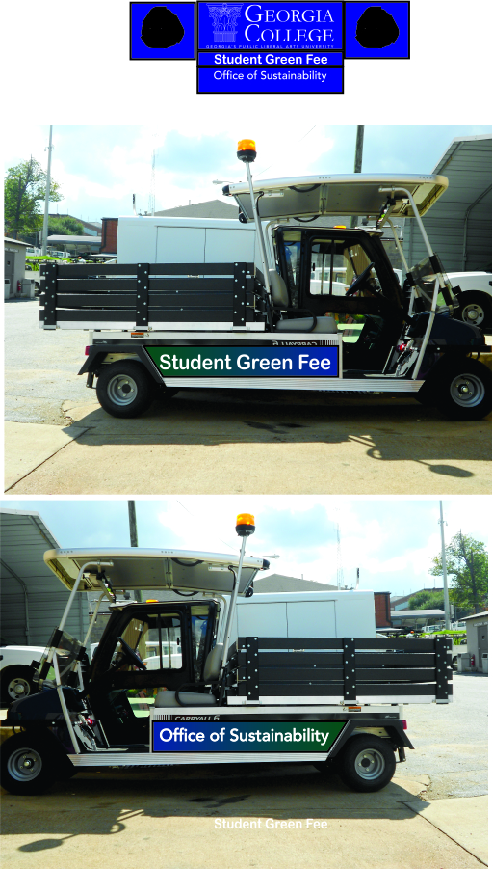
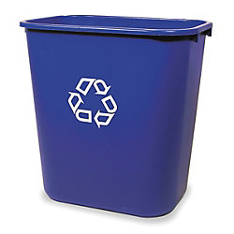
Campus Green Initiative Fund
Student Funding grant to Boost Recycling Rates
3. What would help you to recycle more?
a. Having a close place to take recycled items |  |  |  | 81
b. Having a recycling facility that stays open longer |  |  |  | 31
c. Having a small bin in your room/apartment to keep recyclable itmes |  |  |  | 63
d. Having better instructions on how and where to recyle |  |  |  | 33
e. Not having to separate reclable itmes into different types |  |  |  | 28
f. Having your friends recycle too |  |  |  | 28
g. Nothing would get me to participate in the program |  |  |  | 4
4. Do you have any suggestions on how to improve the program?
More bins and volunteers to help and places to recycle
Advertise
Have recylable bins in dorms
Info on how to separate/which groups to separate things into
Provide a bin for apartments
Seeing more recycling bins around campus
Involve people more and increase facilities
Maybe have awards for the most recycled!
Permanent Recyle Coordinator (paid)

Slide 22
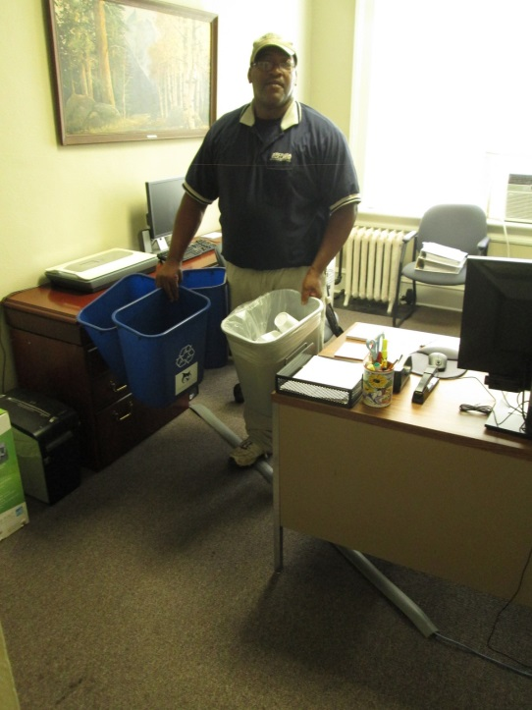
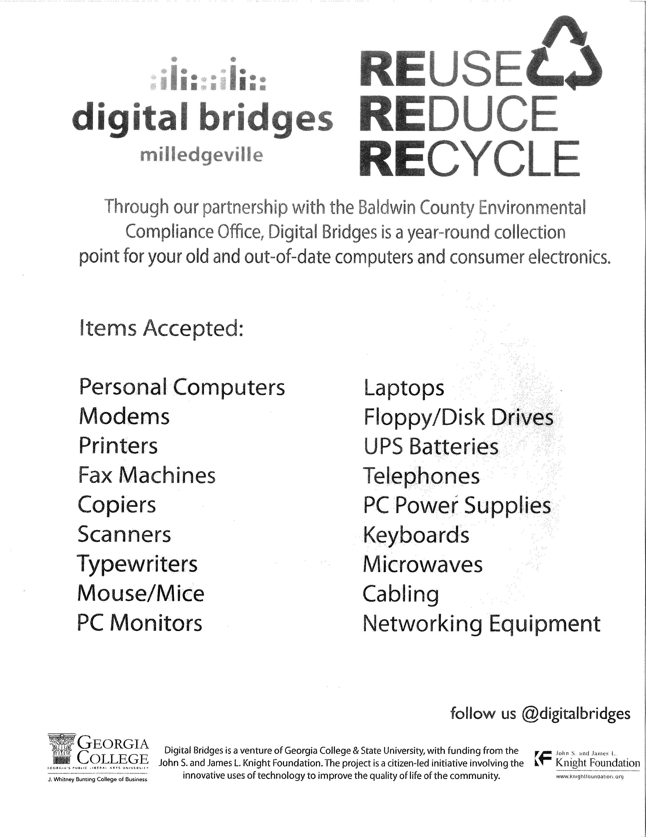
2013 ‘New’ Recycling Plan
Reorganization within Facilities Operations
  Custodial support

Slide 23
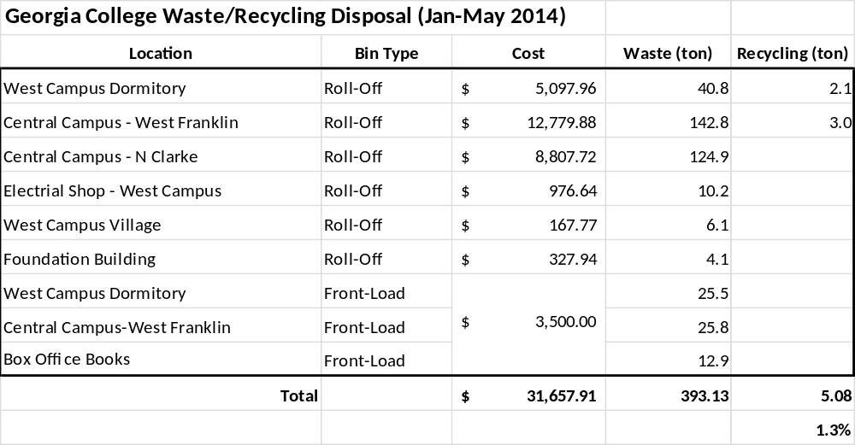
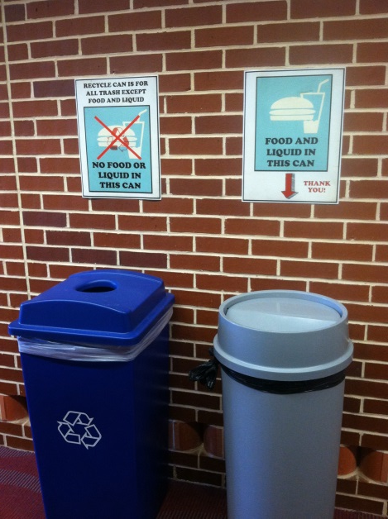
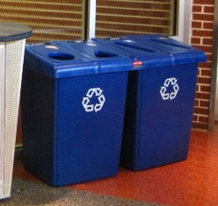
Where We Are Now
Academic Buildings
Residence Halls
Electronics
Composting

Slide 24
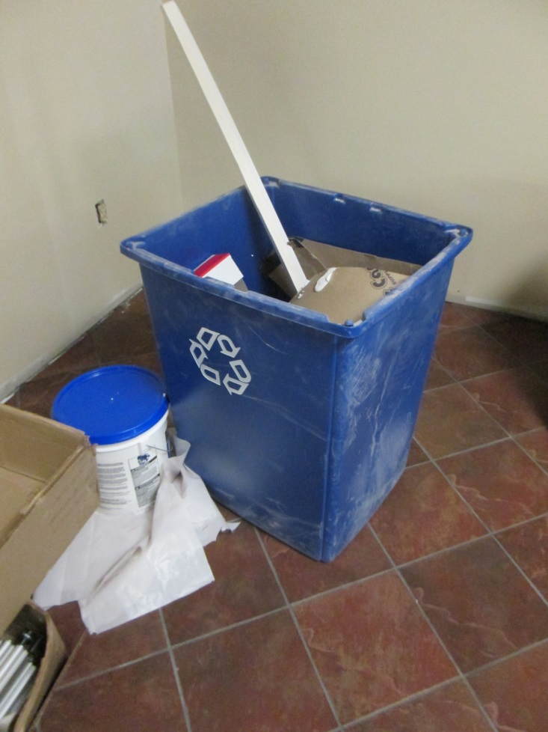
Issues
Building Services will not pick up wet trash from offices.
Wet trash includes any type of food/liquid waste or containers with food/liquid waste in them.
Wet trash mixed with recyclable materials contaminates the entire bin.
Occupants of the buildings are responsible for disposing of wet trash in the designated common areas for wet trash.
Restrooms, lounge and vending areas are the designated areas for wet trash.
Any building occupants who chooses to bring personal trash cans on campus should clearly label those containers as personal property with the individual’s name.
If a personal container is not clearly labeled, Building Services staff will assume it to be GC property and confiscate it.
GC does not supply recycling bins or trash cans in classrooms.
GC does not supply plastic bags to building occupants for recycling or wet trash.
Recyclable materials are collected once a week
Wet trash is collected from the common areas daily.
Building Services uses clear bags for collecting recyclable materials and black bags for collecting wet trash.

Slide 25
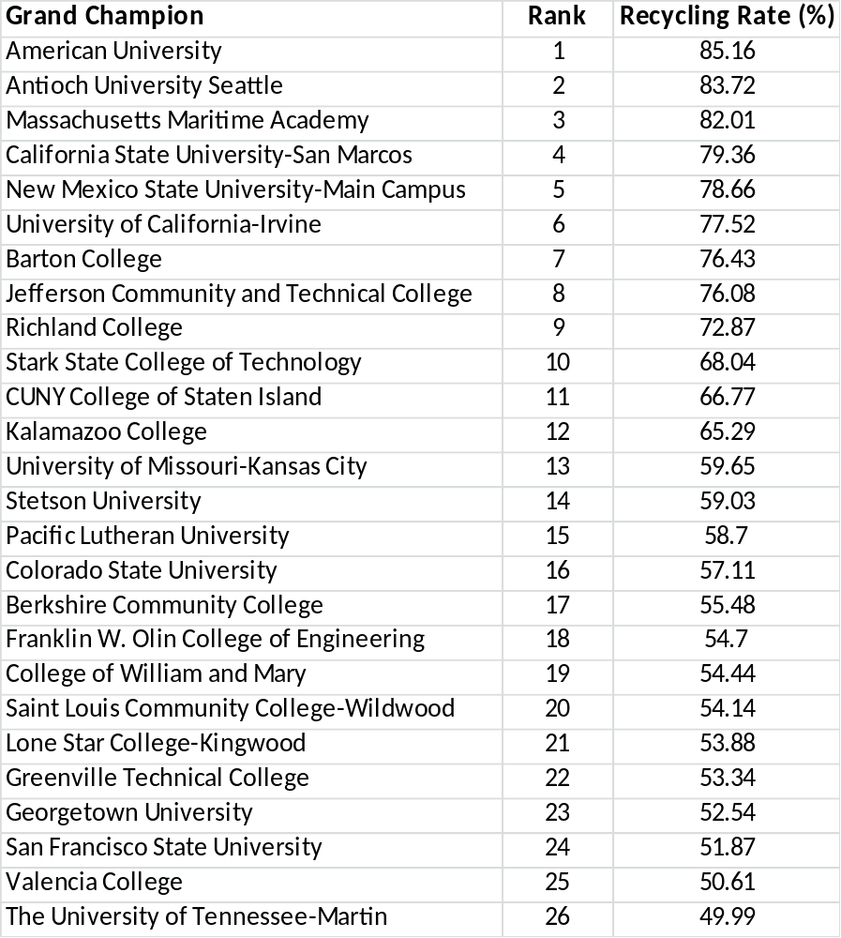
Where We’d Like to Be
Peer Institutions

